Slide 1
Lourdes Ortega
Data Analyst Project Portfolio
Link: https://github.com/OrtegaL95

Slide 2

Introduction
"With a background in marketing and public relations, I use data storytelling to turn complex data into engaging stories that drive strategic decisions and make a real impact in federal government.“

Slide 3
GameCo
Flu Season
Rockbuster
Instacart
Global Bank
Federal Building Utilization Analysis
Projects

Slide 4
GameCo
Analyzing Global video game sales

Slide 5
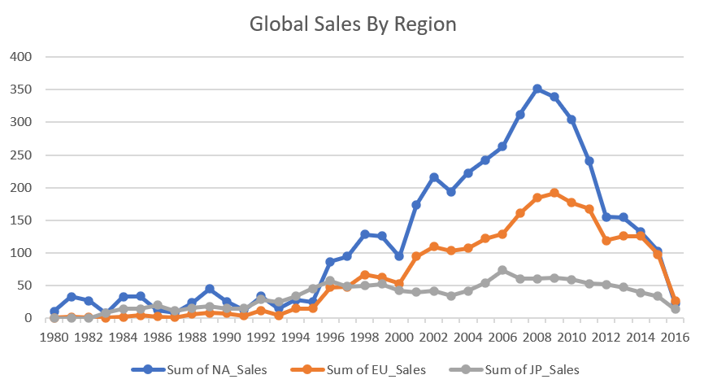
Background
Analyzed global video game sales data for GameCo (1980-2016) to guide market strategy.
Used Excel to perform data cleaning, grouping, summarizing, and descriptive analysis.
Visualized results through charts to extract actionable insights for the company.
Data set from the website VGChartz.com

Slide 6
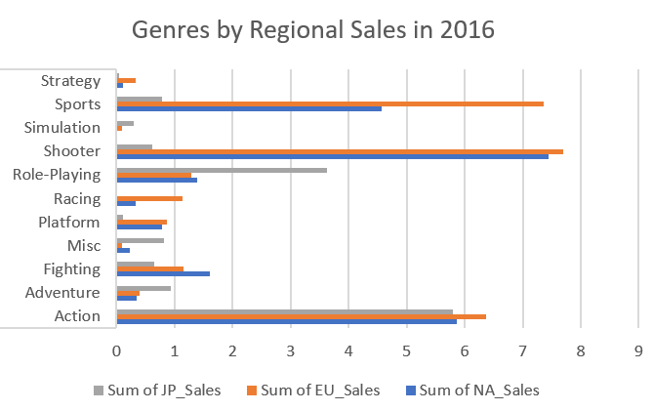
Analysis
Conducted data familiarization and cleaning.
Used Excel pivot tables for grouping and summarizing data.
Distribution analysis highlighted game popularity trends over time and regions.
Challenges included handling missing data, which were addressed through consistent cleaning and validation.
Iterative refinement ensured accurate hypotheses and clear visualizations.

Slide 7
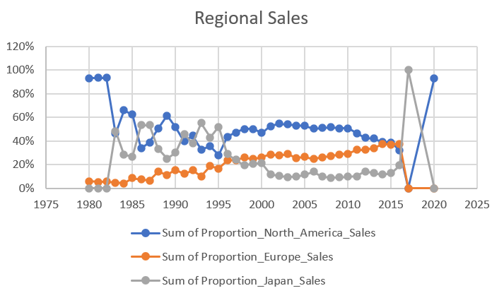
Deliverables & Insights
Final analysis identified popular game genres and regional sales variations, presented through a detailed report and visualizations.
This project enhanced my data cleaning, descriptive analysis, and visualization skills.
Future improvements could include advanced statistical techniques for deeper validation and predictive insights.

Slide 8
Flu Season
Preparing for the Flu Season in the U.S.

Slide 9
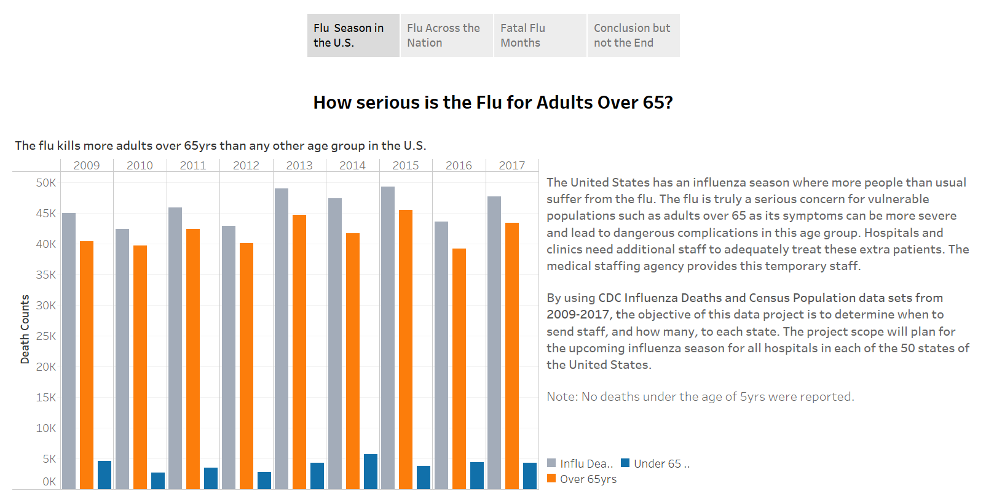
Background
Used Excel for data cleaning, integration, and transformation.
Created a story with dashboards in Tableau.
Data sets from CDC and U.S. Census Bureau
Analyzed trends to forecast staffing needs for a medical staffing agency, aiming to optimize resource allocation during peak flu periods.

Slide 10
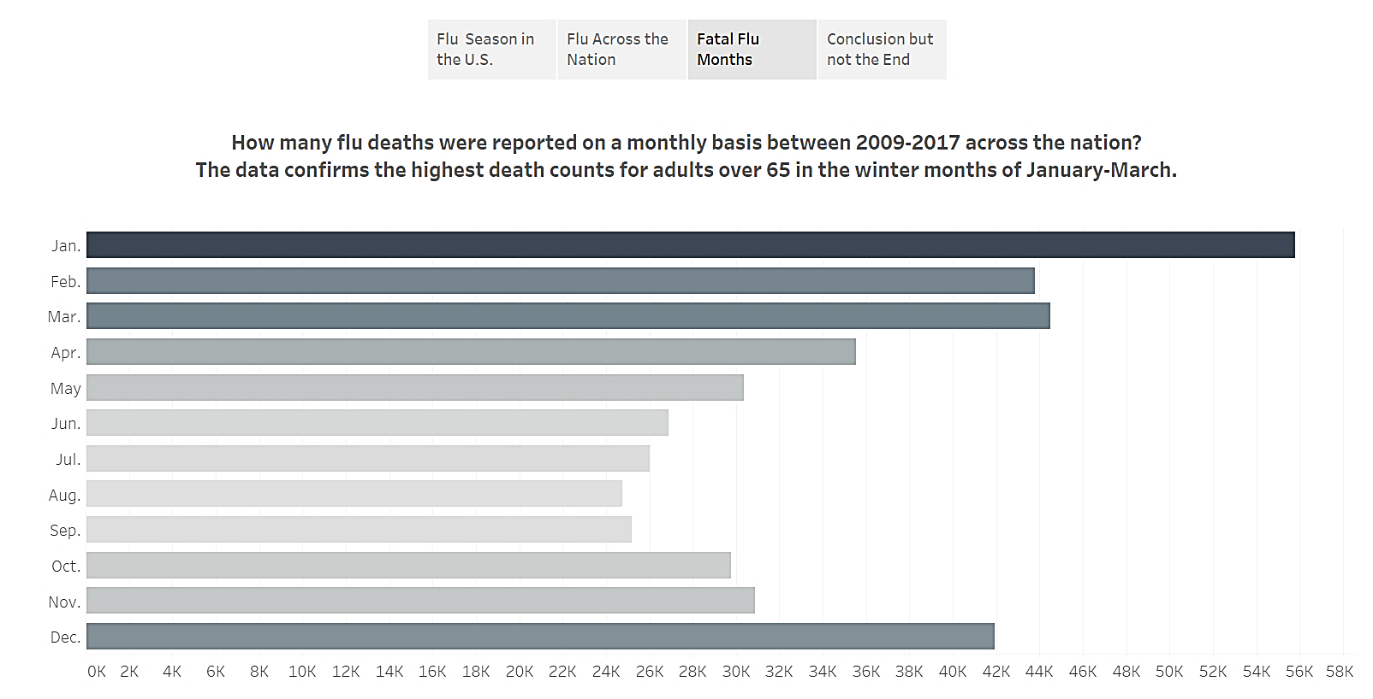
Analysis
Translated business requirements into analytical questions.
Sourced relevant datasets, cleaned and integrated the data.
Statistical hypothesis testing and visual analysis in Tableau.
Identified trends and forecasted flu outbreaks.
Challenges included ensuring data accuracy and integrating diverse data sources effectively.

Slide 11
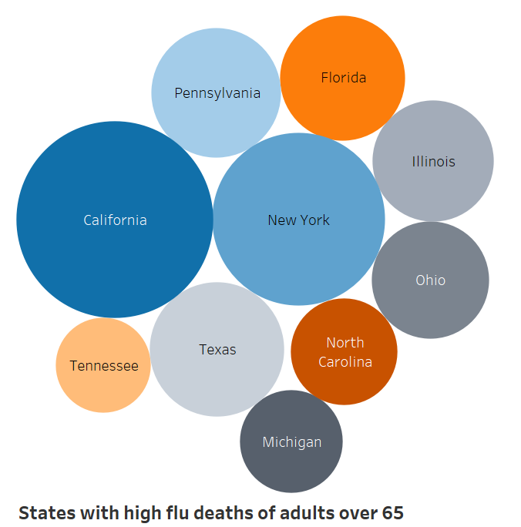
Deliverables & Insights
Final deliverables included a dashboard of staffing recommendation and visualizations in a Tableau storyboard.
The analysis highlighted key trends in flu seasonality and staffing needs, providing actionable insights for better resource management.
Future improvements could involve more sophisticated predictive models to enhance forecast accuracy.

Slide 12
Rockbuster
Answering business questions for an online
video rental company

Slide 13
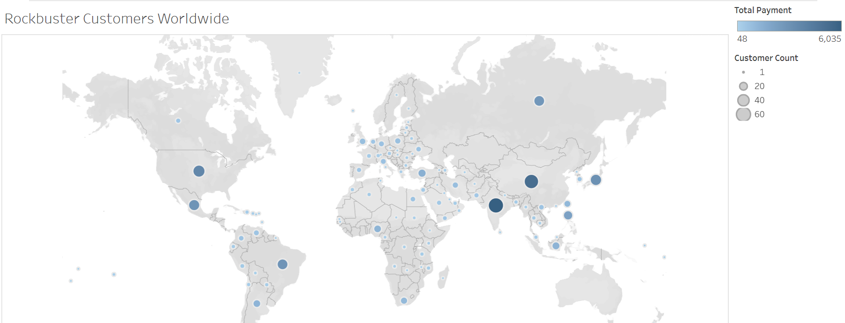
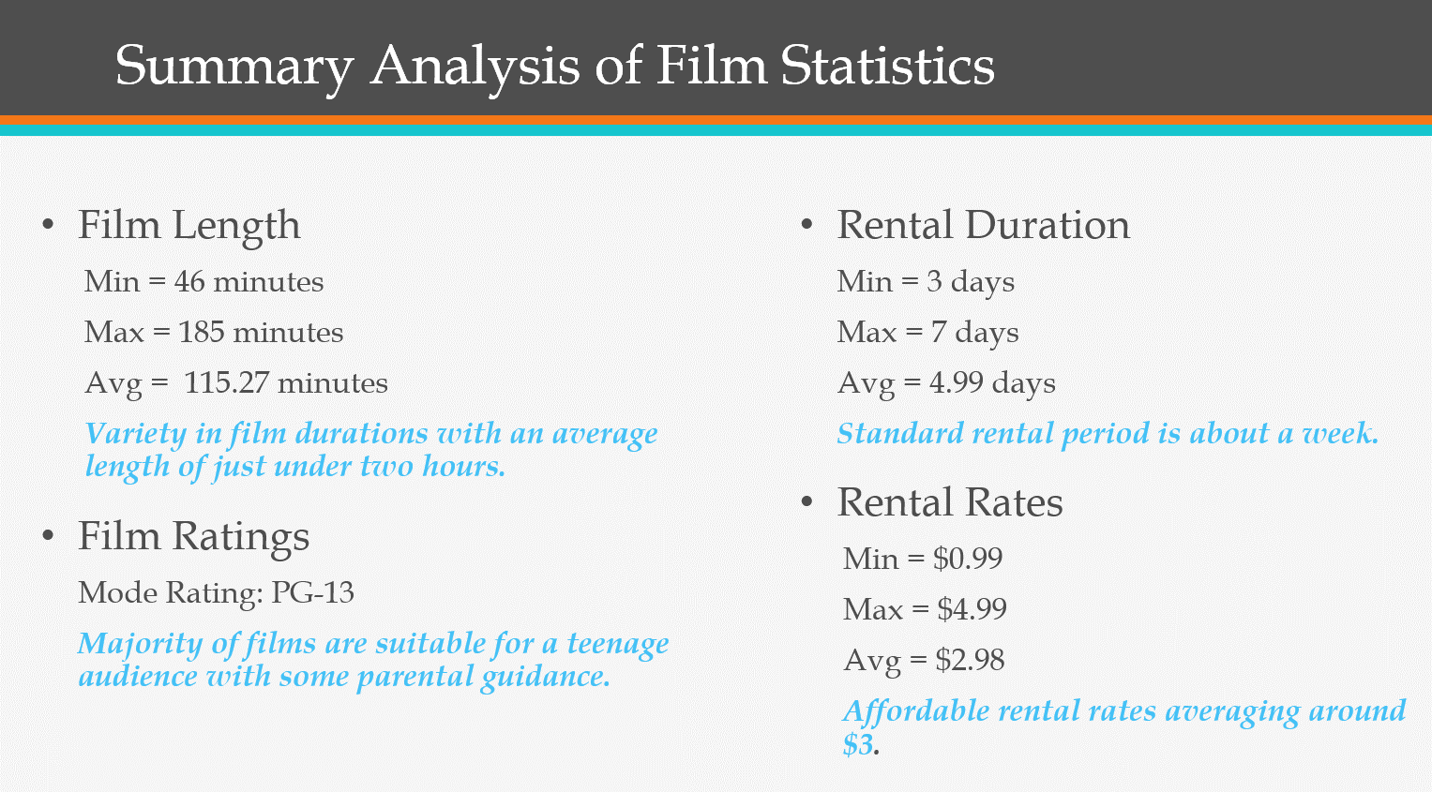
Background
This project aimed to provide insights into movie performance and customer demographics for strategic decision-making.
Analyzed Rockbuster Stealth's data to support their new online video rental service.
Used PostgreSQL to manage data querying, cleaning, and integration.
Data set from Rockbuster and PostgreSQL Database
Tableau visual link of Customer Distribution Bubble Map

Slide 14
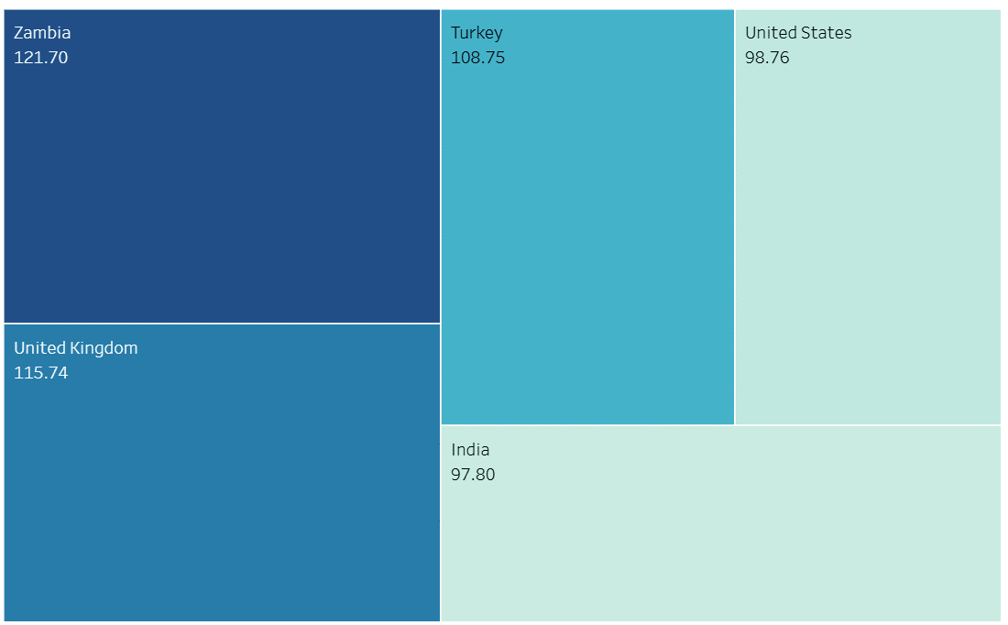
Analysis
Uploaded Rockbuster's data into PostgreSQL relational database.
Challenges included complex joins and ensuring data accuracy, which were addressed by thoroughly cleaning and validating the data.
Used SQL to answer key business questions.
Identified top-performing movies and customer locations.
Tableau visual link of Top 5 Customers by Total Amount Paid Tree Map

Slide 15
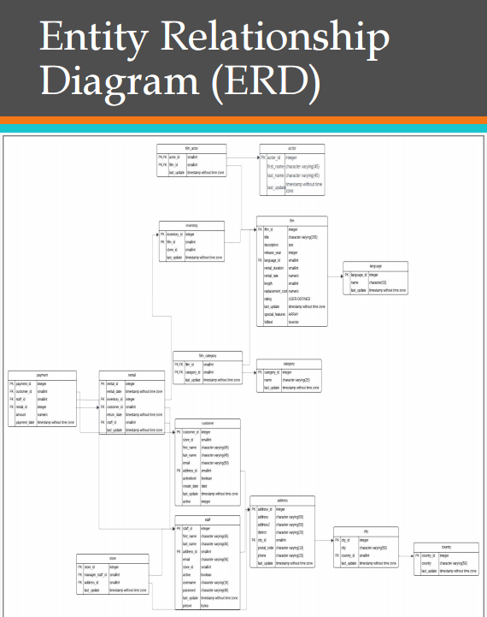
Deliverables & Insights
Final analysis delivered insights on revenue-driving movies and customer demographics.
Results were presented with visualizations in a comprehensive report, technical details of SQL code in Excel, and an ERD plus data dictionary.
This project enhanced my SQL skills and ability to derive actionable business insights.
Future improvements could include advanced predictive analytics for strategic planning.

Slide 16
Instacart
Marketing strategy for an online grocery store

Slide 17
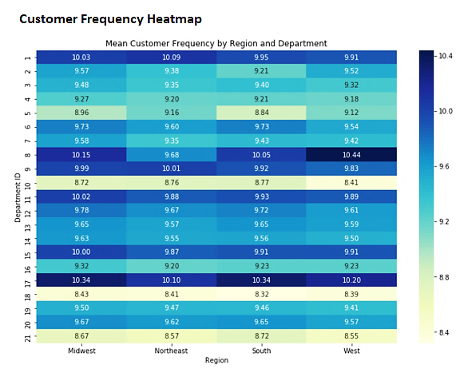
Background
Conducted a detailed analysis of Instacart's sales data to enhance their marketing strategy.
Using Python libraries pandas, NumPy, and matplotlib, explored customer purchasing behaviors and sales patterns to provide actionable insights for targeted marketing campaigns.
Customers Data Set from CareerFoundry.com and Instacart Data Sets and Data Dictionary from Kaggle.

Slide 18
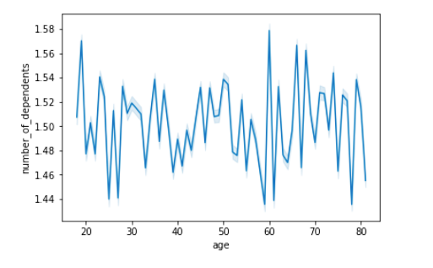
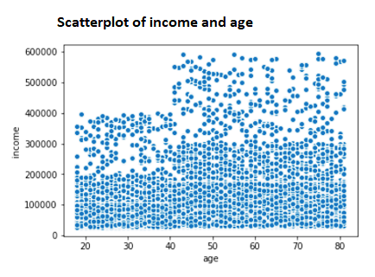
Analysis
Started by cleaning and merging multiple datasets, ensuring data accuracy.
Used pandas for data wrangling and aggregation then identified key trends such as peak shopping times and popular product categories.
Challenges included handling large datasets and ensuring meaningful data transformation, which were dealt with efficient coding practices.

Slide 19
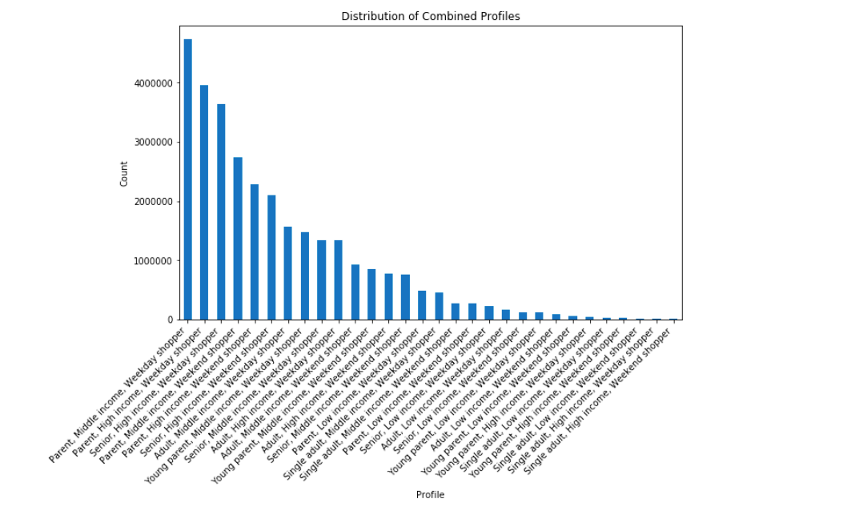
Deliverables & Insights
The final analysis provided insights into customer segmentation, highlighting peak sales times and popular products.
A comprehensive report presented population flows, consistency checks, wrangling steps, column derivations, visualizations, and recommendations.
This project improved my data wrangling, aggregation, and visualization skills in Python.
Future work could include advanced predictive modeling to refine marketing strategies further.

Slide 20
Global Bank
Anti-money laundering projects

Slide 21
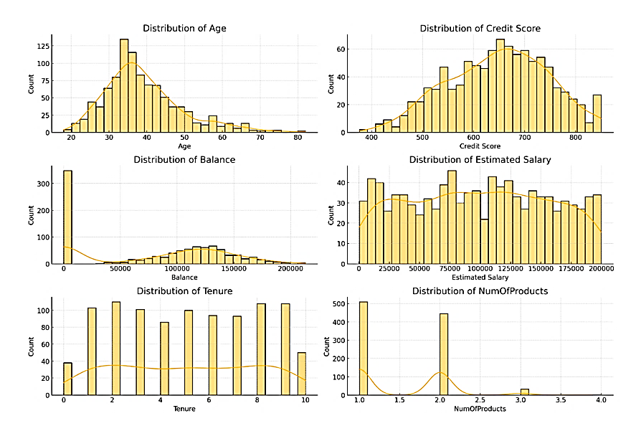
Background
Supported a global bank's anti-money-laundering compliance department.
Using big data tools, assessed client and transaction risks. Conducted a customer distribution analysis.
Conducted predictive analysis, time-series forecasting, and addressing data ethics concerns.

Slide 22
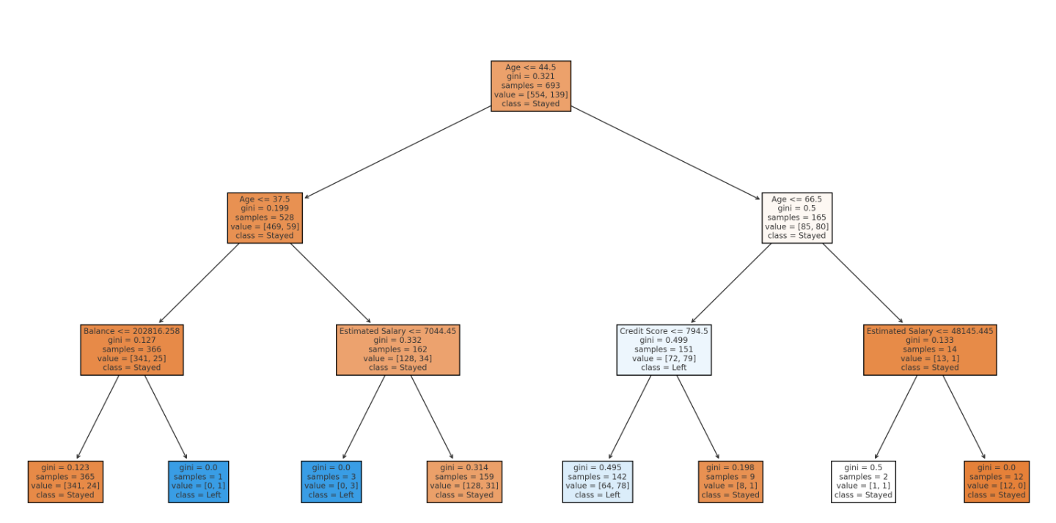
Analysis
Began by understanding structured and unstructured data characteristics.
Used Excel, Python and GitHub; cleaned and mined data, creating predictive models and time-series forecasts.
Created a decision tree with key factors leading to customer churn: Age, Account Balance, Credit Score, and Salary.
Addressing data bias and ethical issues was crucial in maintaining data integrity and security.

Slide 23
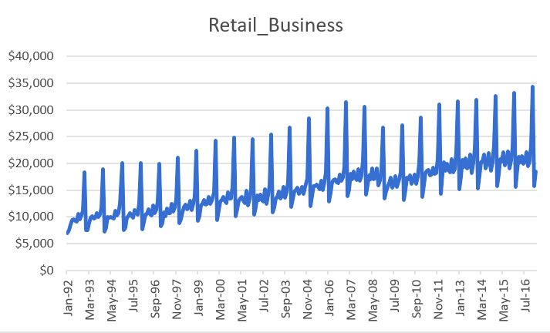
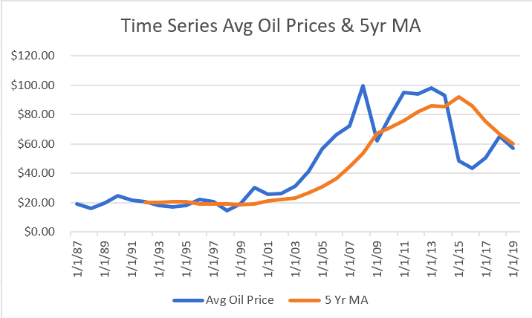
Deliverables & Insights
The project delivered insights into high-risk transactions and client profiles, aiding the bank's compliance efforts.
Detailed visualizations and reports were created to communicate findings.
This project enhanced my skills in big data analytics, CRISP-DM Methodology, time series analysis, bias in predictive models, regression vs. classification, and ethical data handling.
Future work could integrate advanced machine learning techniques.

Slide 24
Federal Building Utilization Analysis
Advanced Analytics Dashboard
Tableau Link
Notes:
https://public.tableau.com/shared/SNTHMK47F?:display_count=n&:origin=viz_share_link

Slide 25
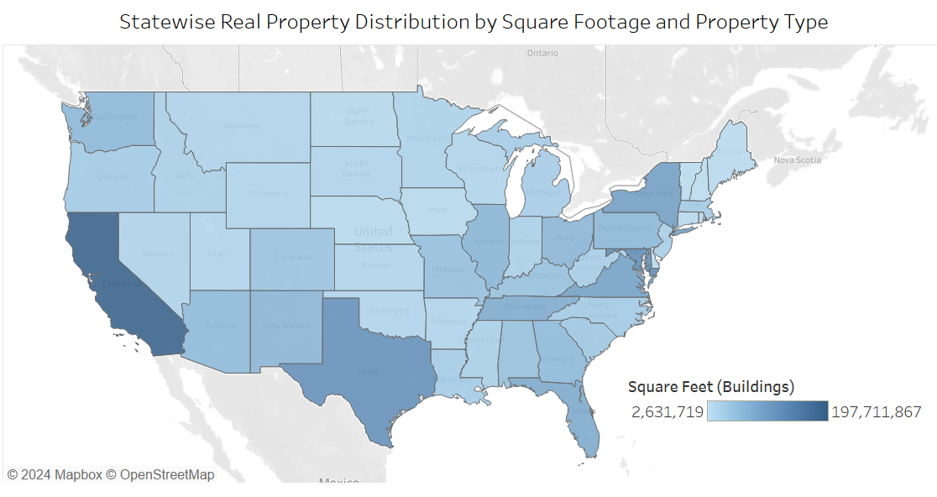
Background
Chose data sets for in-depth analysis on U.S. federal building utilization.
Used Python libraries to clean data and create subsets for supervised learning, regression analysis, clustering, and time series analysis.
Collected FY 22 & FY23 Federal Real Property Profile data sets from data.gov via the
U.S. General Services Administration
Developed interactive and engaging data dashboards in Tableau.
Notes:
Beginning
In my A6 Advanced Analytics & Dashboard Design project, I selected a dataset to perform an in-depth analysis. Using Python visualization libraries, I created engaging and interactive data dashboards. This project focused on enhancing my skills in machine learning, regression analysis, and advanced data visualization techniques.

Slide 26
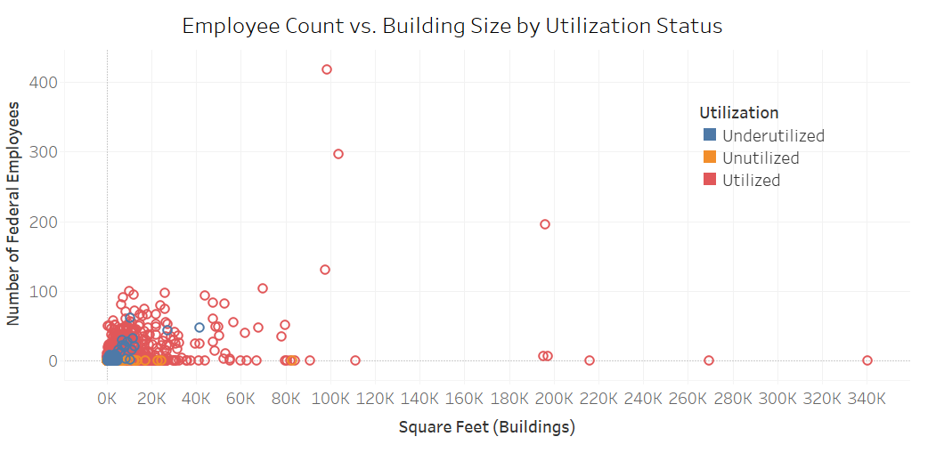
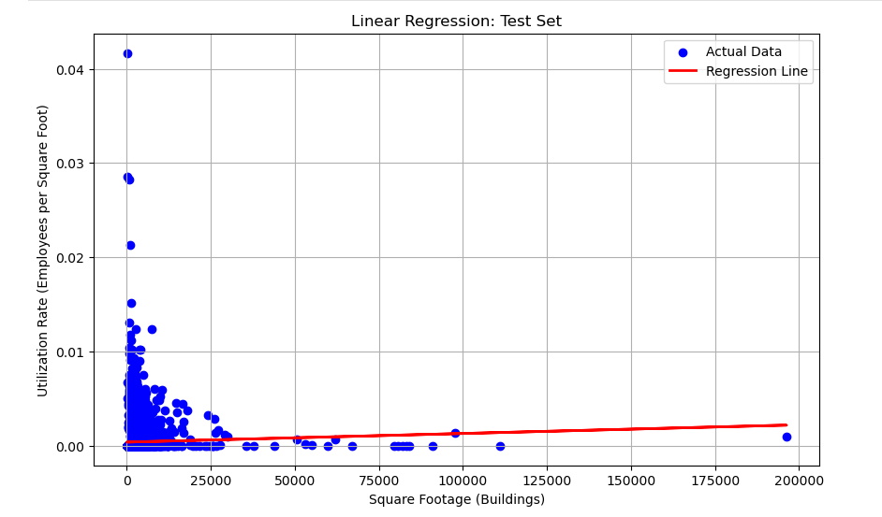
Analysis
Identified key variables and explored crucial relationships for analysis.
Applied machine learning models and regression analysis to uncover deeper insights.
Challenges included making user-friendly and accessible dashboards.

Slide 27
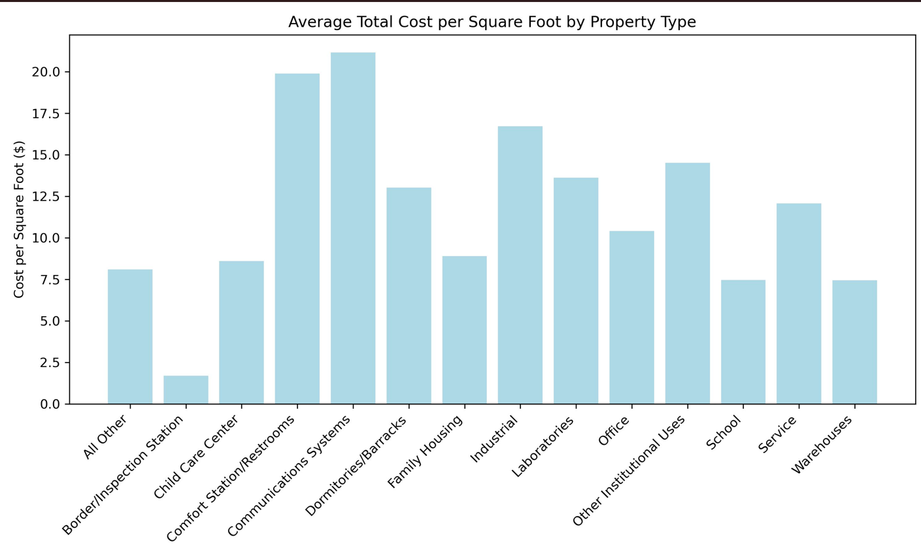
Deliverables & Insights
Deliverables included an interactive Tableau storyboard including various dashboards and comprehensive Jupyter Notebooks.
Analysis showed variability in federal property costs and utilization, highlighting opportunities for optimizing office space and reducing high-cost areas.
This project significantly improved my skills in advanced analytics, machine learning, and data visualization.

Slide 28
Conclusion
Journey
Showcased my journey in data analytics, transforming complex data into impactful stories.
Skills
Each project highlights my skills in data cleaning, analysis, and visualization.
Experience
Unique perspective in data storytelling, driving strategic decisions and delivering actionable insights.
Integrating advanced predictive models and refining dashboards for better decision-making
Future

